Slide 1
Annotation

Slide 2
What is an annotation?
An annotation is a note of explanation or comment added to a text or diagram – kind of like a side-note!
Why do good lit students do this?
It provides interaction with the text, so you will understand more of what you are reading.

Slide 3
Why it’s important to annotate…
Although annotation may feel like a pain in the behind, it will be an immense aid in understanding what you read.
In order to become a thoughtful and thorough reader and writer, you should choose to annotate.
Gives context to what you are reading
Highlights/emphasizes specific points
Provides fodder for your literary essays
Provides fodder for literary discussions

Slide 4
What to write while annotating
Ask questions as you read (examples)
What does this mean?
Has the writer done this for a purpose?
Why is this language used?
Write your questions in the margins.
React to what you read:
Surprised?
Angered?
Moved emotionally?
Why do I feel she is devouring him?

Slide 5
What to write while annotating…cont’d
Make connections:
Is there a connection with another piece you have read? Does this remind you of something else?
Record connections to create meaning and relevancy.

Slide 6
What to write while annotating…cont’d
Leave a trail of literary bread crumbs:
Did you recognize an idea you think might be worth remembering?
Is there a ‘big idea’ that is at the foundation of the article?
Is there a comment or idea that relates to the prompt or essay question?
Is there syntax that makes you go “Hmmmm?”
Do you see any rhetorical strategies or appeals?
These are important to locate, as they are what you might quote in your investigation or written essay later.

Slide 7
What to write while annotating…cont’d
Define/note new words:
Reading comprehension problems occur because of unfamiliar vocabulary.
It’s not too much trouble to look up the word in the dictionary.
If you physically can’t look up the word as you encounter it, circle it and look it up at your first opportunity.
CONTEXT CLUES will come in handy if you cannot look up a word.

Slide 8
After you read…
Summarize what you’ve read:
To assure comprehension, rewrite the piece noting the essential points, using only a couple of sentences.
This is key to truly understanding a piece of literature or nonfiction.
Much more difficult with a LONG piece of literature, but is doable with shorter pieces and poetry.

Slide 9
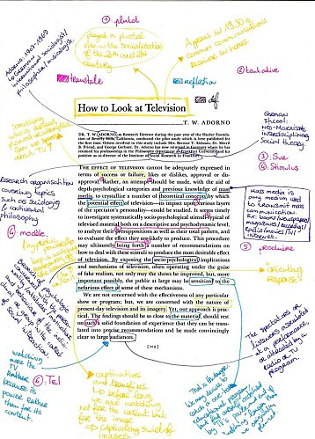
This is what it can look like…
Some people use different colors for different notations.
Some people use highlighters, but you can’t use them in the AP Lit/Comp exam.
Find your own technique, just do it.

Slide 10
Homework – Due Friday 8/26
Read the excerpt by Eudora Welty
Annotate it as preparation for discussion
Focus on:
Diction
Figurative Language
Imagery
Syntax

